Slide 1
Game of Death
Kevin Holmes, Alex Buchanan, Mike Danino, Jess Lai

Slide 2
The Team
Kevin Holmes – Team Lead, architect, algorithms, and graphics
Alex Buchanan – Seed factory work, and level completion
Mike Danino – Pasting and button systems
Jess Lai – Button system and seed selection

Slide 3
Background
Conway’s Game of Life
Simple algorithm, creates complex systems
Created in the 70’s
We added some rules to turn it into a game

Slide 4
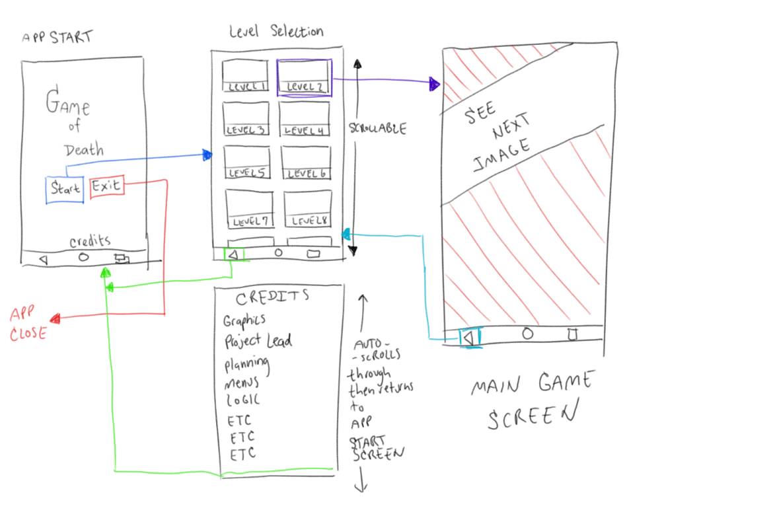
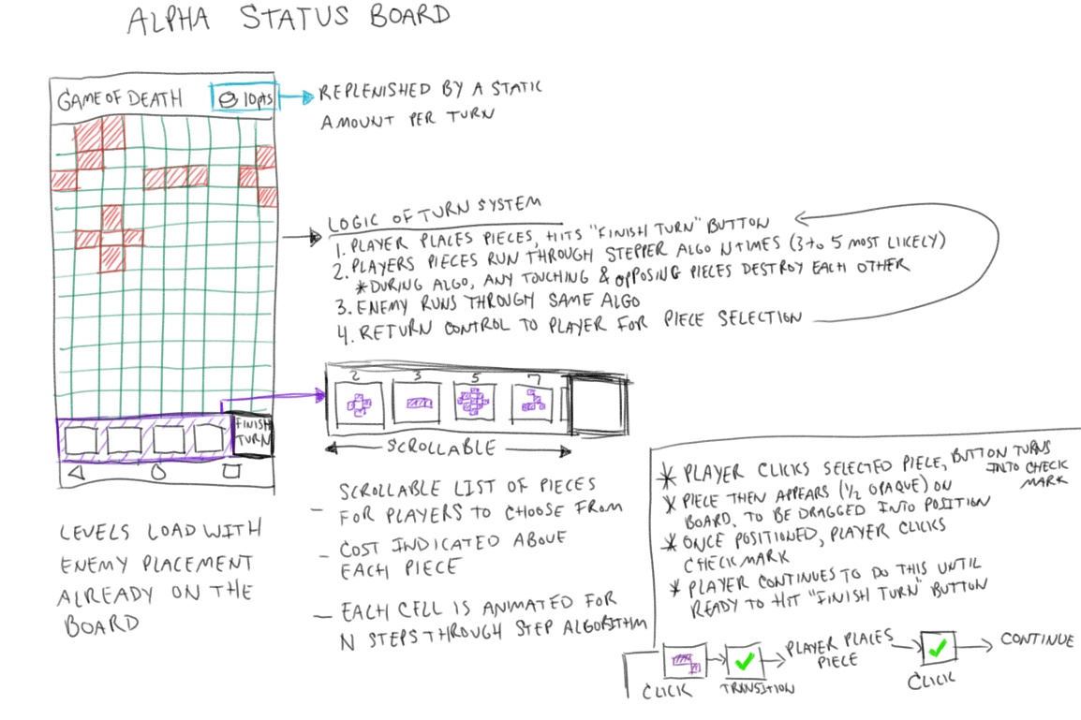
Planning

Slide 5
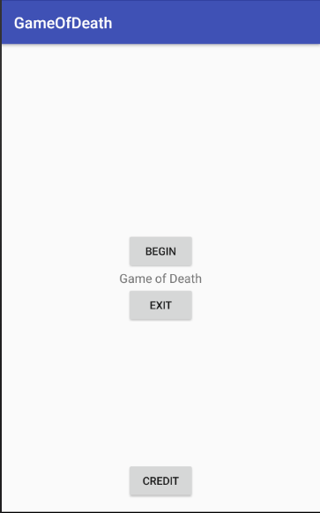
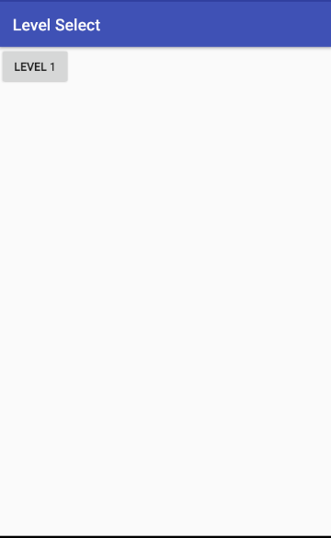
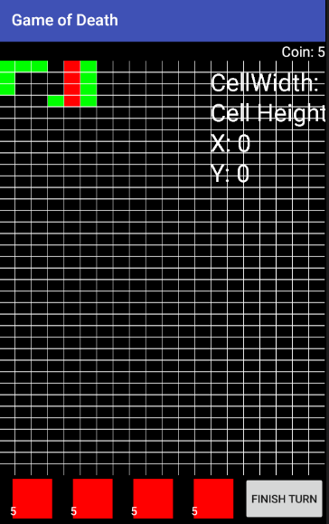
Initial Implementation

Slide 6
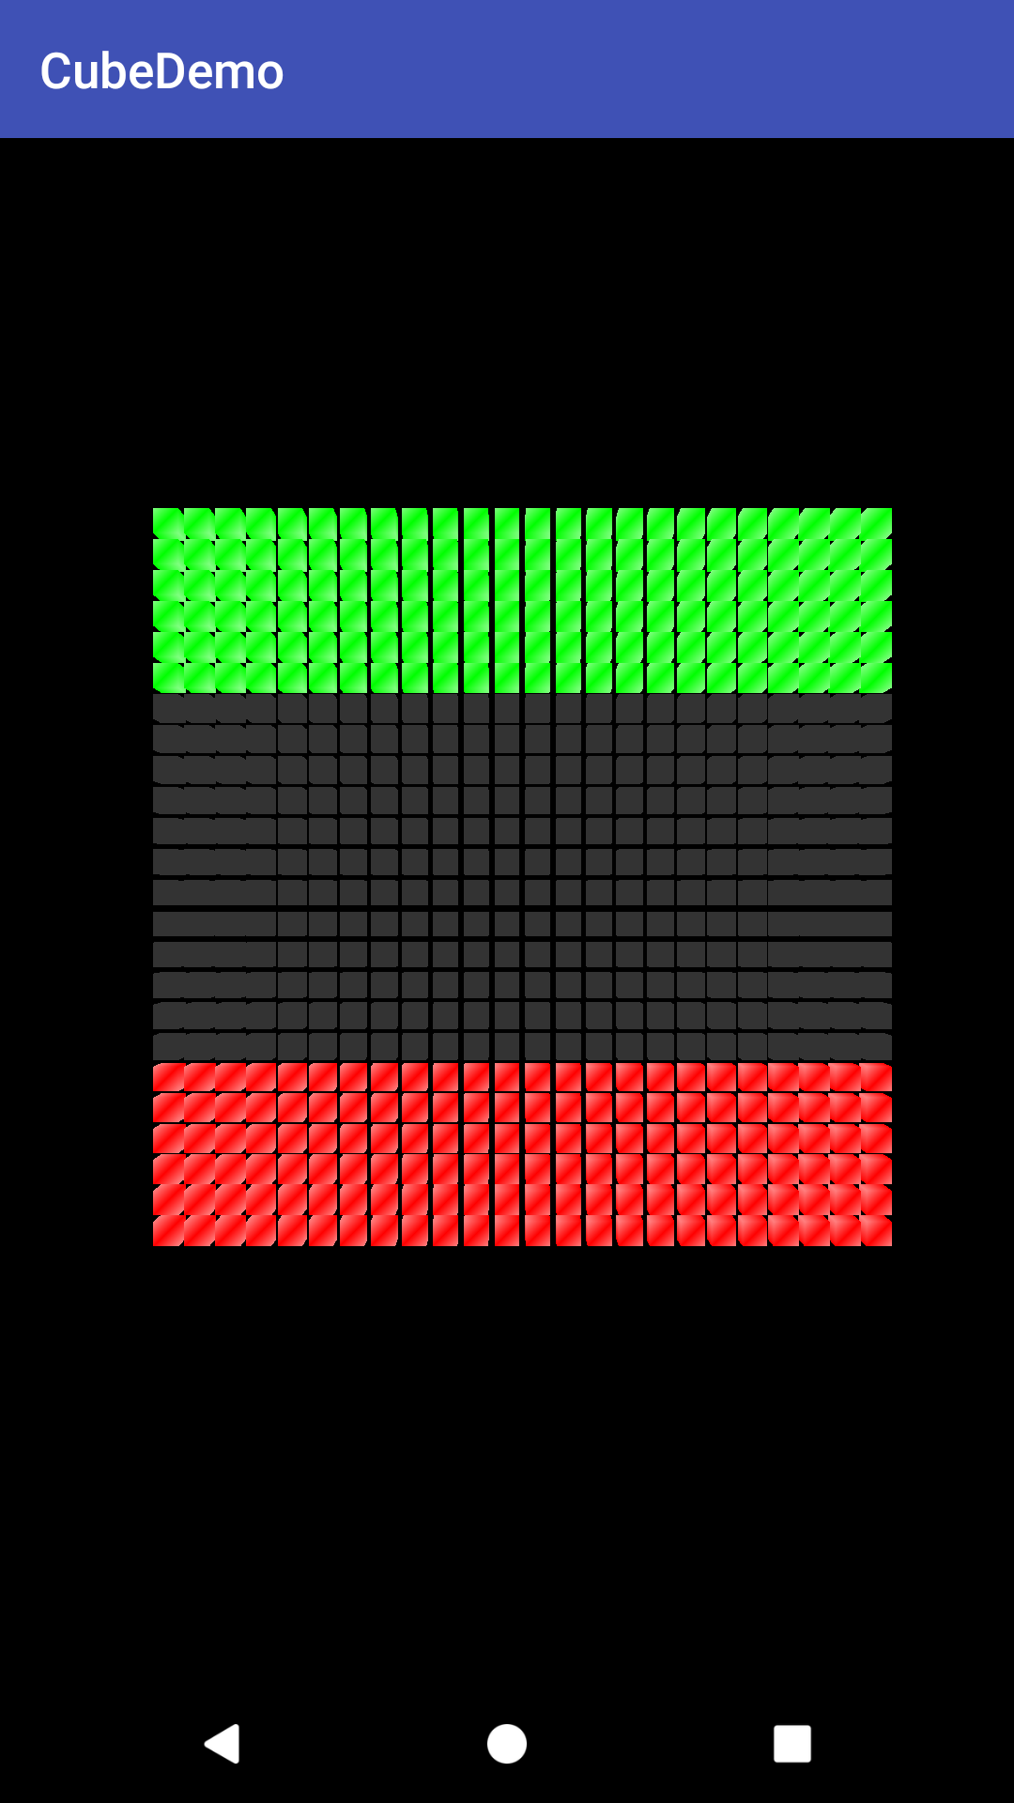
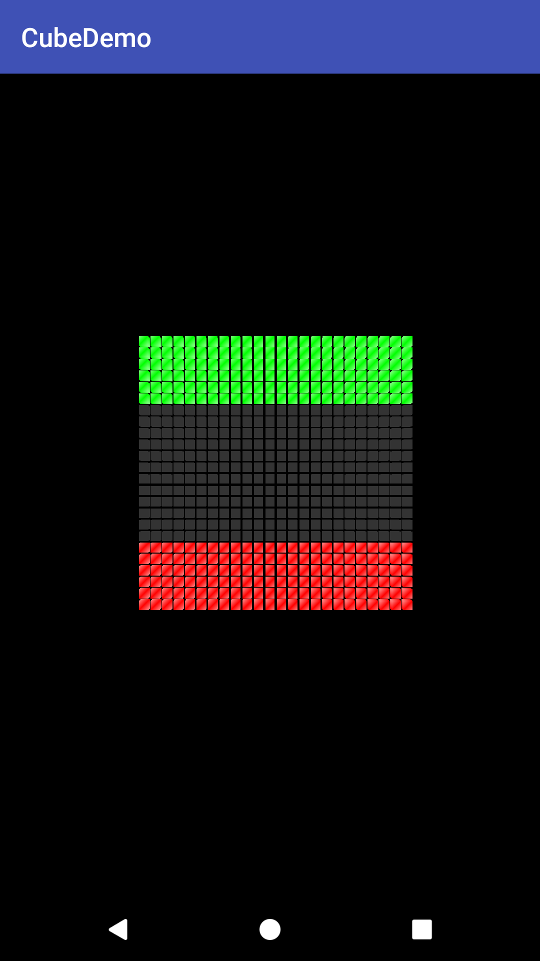
Intermediate OpenGL Implementation

Slide 7
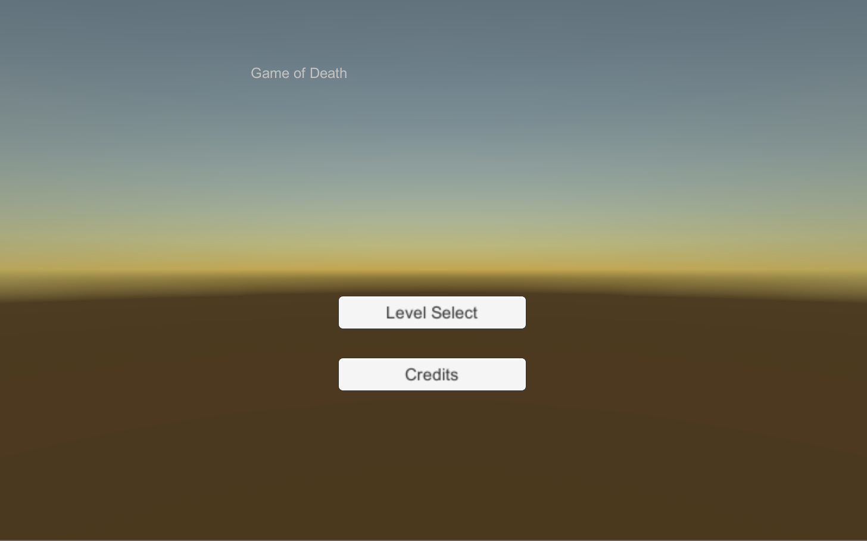
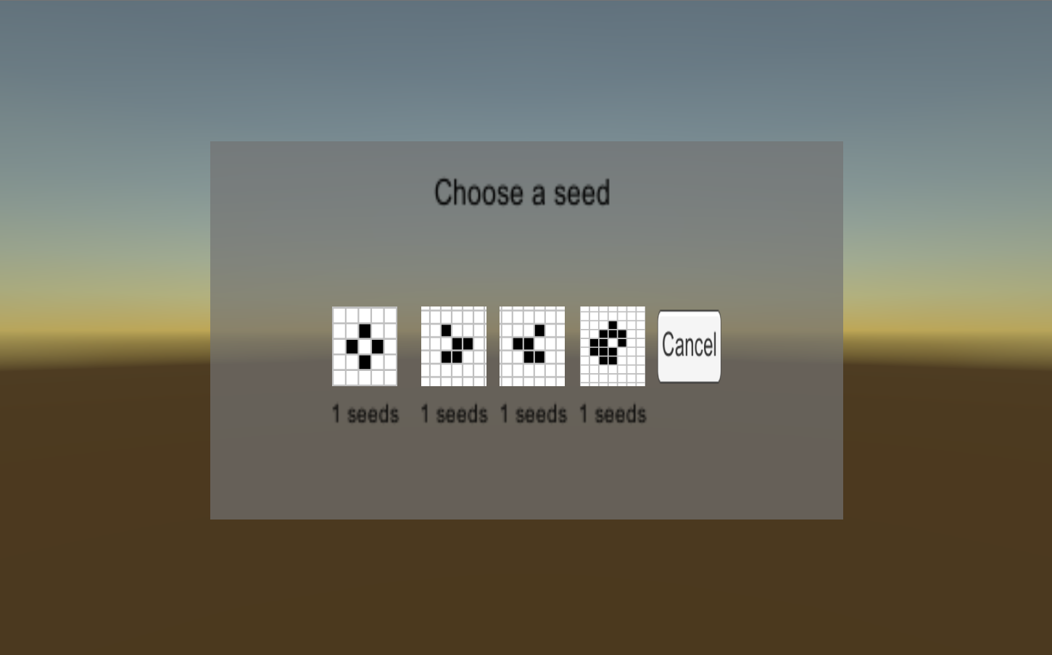
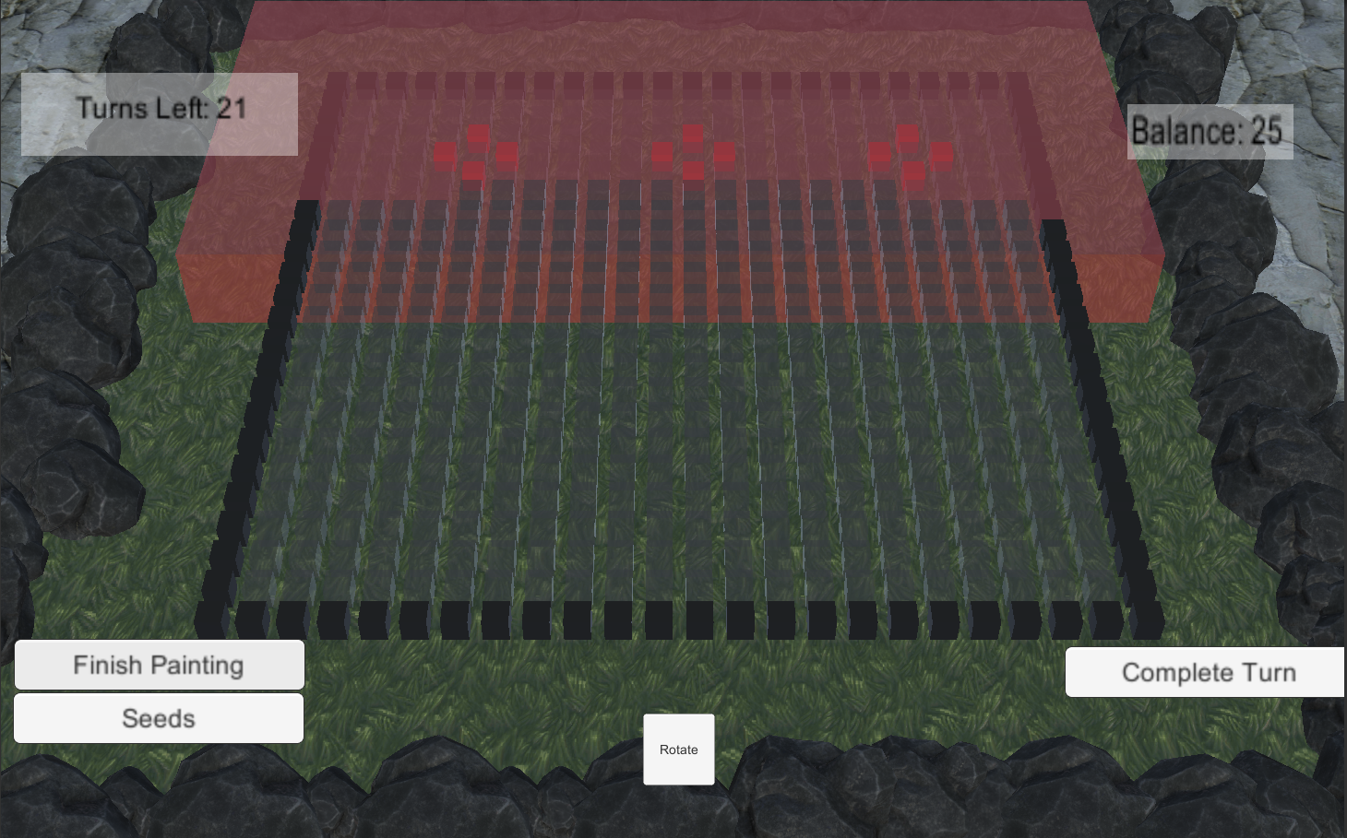
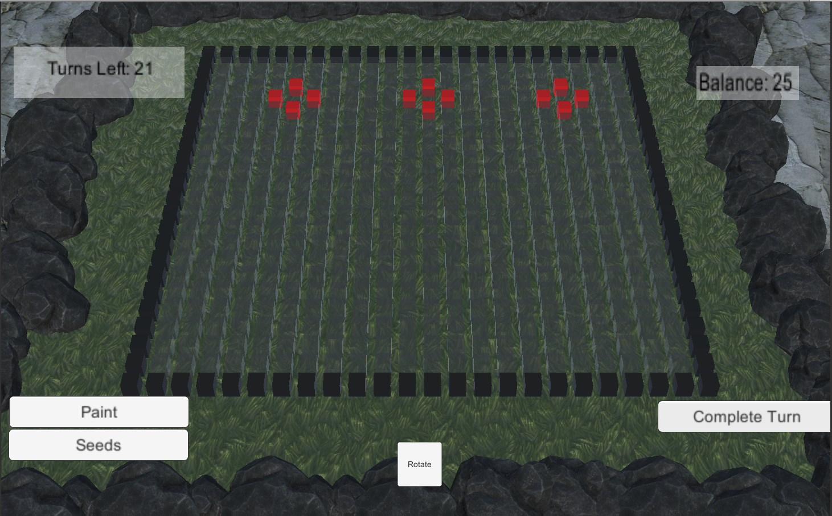
Unity Implementation

Slide 8
Questions?

